Slide 1
Can this technology be used in ways other than how it’s marketed?

Slide 2
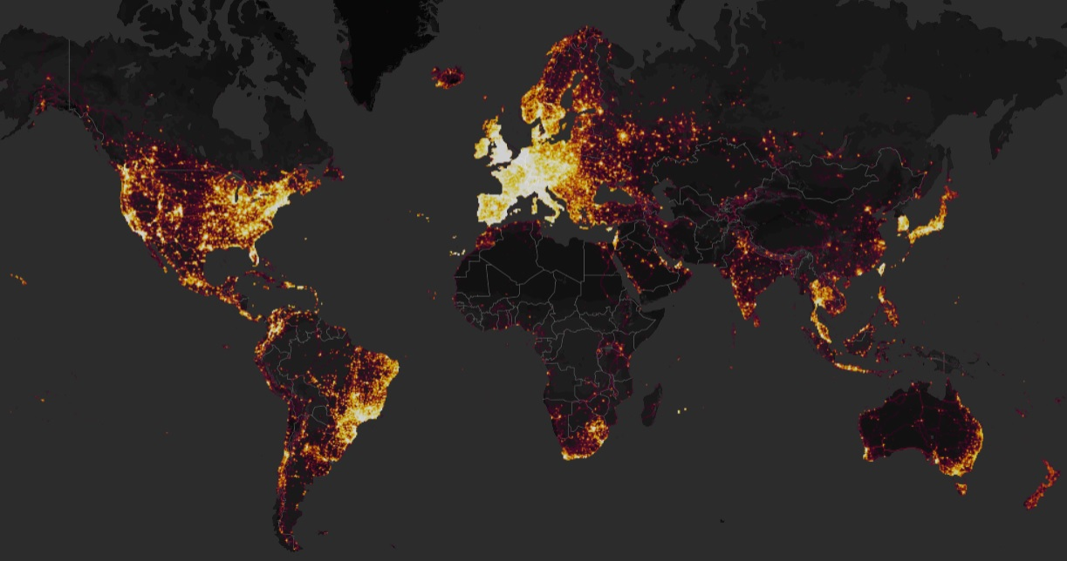
From: https://www.nytimes.com/2018/01/29/world/middleeast/strava-heat-map.html?searchResultPosition=2
Notes:
Strava global heatmap
Security issues identified in January 2018 by Nathan Ruser, an Australian undergraduate

Slide 3
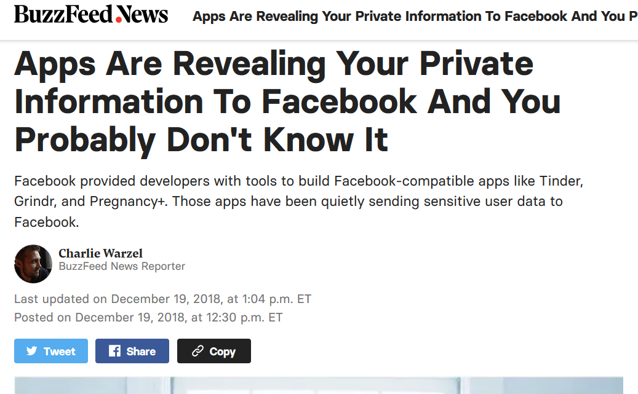
From: https://www.buzzfeednews.com/article/charliewarzel/apps-are-revealing-your-private-information-to-facebook-and
Notes:
FB distributes something called its “Software Developer Kit” to 3rd party app developers. “Through its SDK, Facebook provides app developers with data about their users, including where you click, how long you use the app, and your location when you use it. In exchange, Facebook can access the data those apps collect, which it then uses to target advertising relevant to a user’s interests. That data doesn’t have your name attached, but as Mobilsicher shows, it’s far from anonymized, and it's transmitted to Facebook regardless of whether users are logged into the platform.”
Includes: “IP address of the device that used the app, the type of device, time of use, and a user-specific Advertising ID, which allows Facebook to identify and link third-party app information to the people using those apps. “
This co-locates information that people may want to keep separate
“As long as you’ve logged into Facebook on your mobile device at some point (through your phone’s browser or the Facebook app itself), the company cross-references the Advertising ID and can link the third-party app information to your profile. And even if you don’t have a Facebook profile, the data can still be transmitted and collected with other third-party app data that corresponds to your unique Advertising ID.”

Slide 4
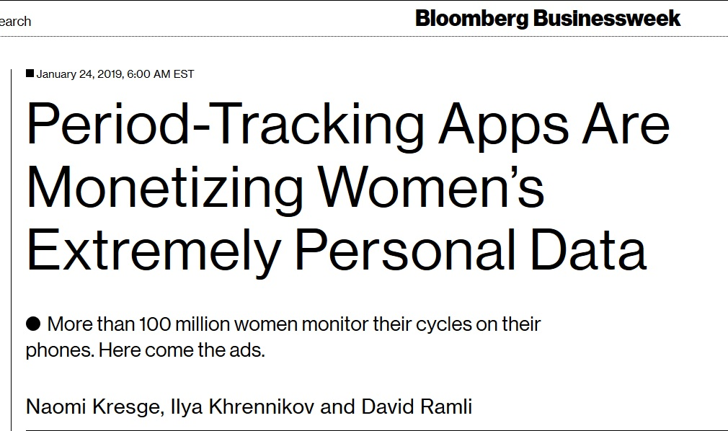
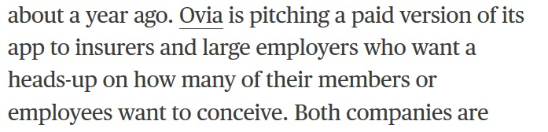
From: https://www.bloomberg.com/news/articles/2019-01-24/how-period-tracking-apps-are-monetizing-women-s-extremely-personal-data
Notes:
More than 100 million women track menstrual cycles on smart phones
Apps sell info to advertisers
Ovia, one app, marketing a paid version to insurers and employers

Slide 5
Does the privacy of the consumer depend on the good intentions of employees? (i.e. privacy by policy vs. privacy by design)

Slide 6
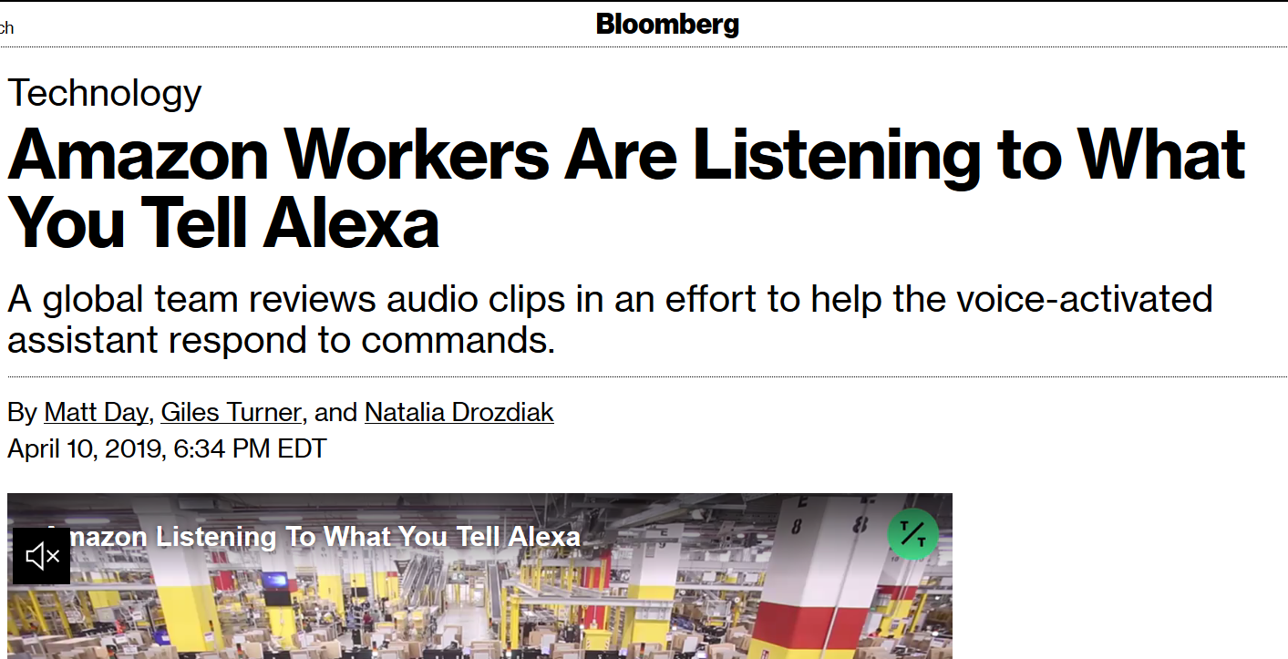
From: https://www.bloomberg.com/news/articles/2019-04-10/is-anyone-listening-to-you-on-alexa-a-global-team-reviews-audio
Notes:
“Amazon.com Inc. employs thousands of people around the world to help improve the Alexa digital assistant powering its line of Echo speakers. The team listens to voice recordings captured in Echo owners’ homes and offices. The recordings are transcribed, annotated and then fed back into the software as part of an effort to eliminate gaps in Alexa’s understanding of human speech and help it better respond to commands. ”
“A screenshot reviewed by Bloomberg shows that the recordings sent to the Alexa reviewers don’t provide a user’s full name and address but are associated with an account number, as well as the user’s first name and the device’s serial number.”

Slide 7
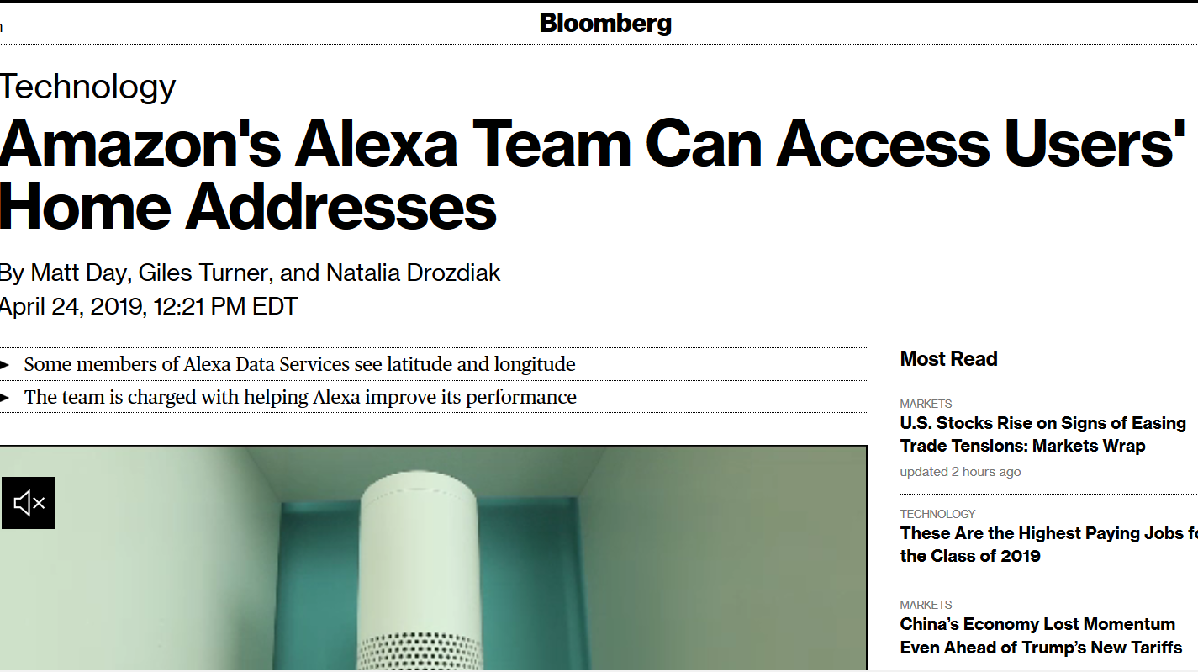
From: https://www.bloomberg.com/news/articles/2019-04-24/amazon-s-alexa-reviewers-can-access-customers-home-addresses
Notes:
“Team members with access to Alexa users’ geographic coordinates can easily type them into third-party mapping software and find home residences, according to the employees, who signed nondisclosure agreements barring them from speaking publicly about the program.
While there’s no indication Amazon employees with access to the data have attempted to track down individual users, two members of the Alexa team expressed concern to Bloomberg that Amazon was granting unnecessarily broad access to customer data that would make it easy to identify a device’s owner.”

Slide 8
If I’m already paying for this thing, why should it monetize my data?

Slide 10
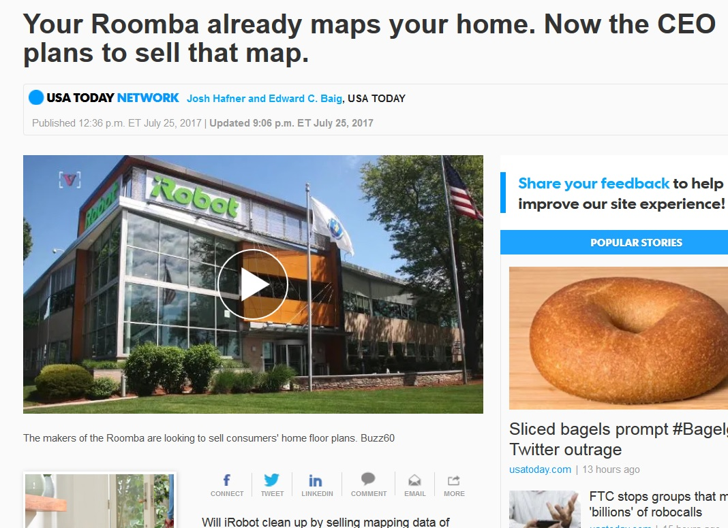
From: https://www.usatoday.com/story/tech/nation-now/2017/07/25/roomba-plans-sell-maps-users-homes/508578001/

Slide 11
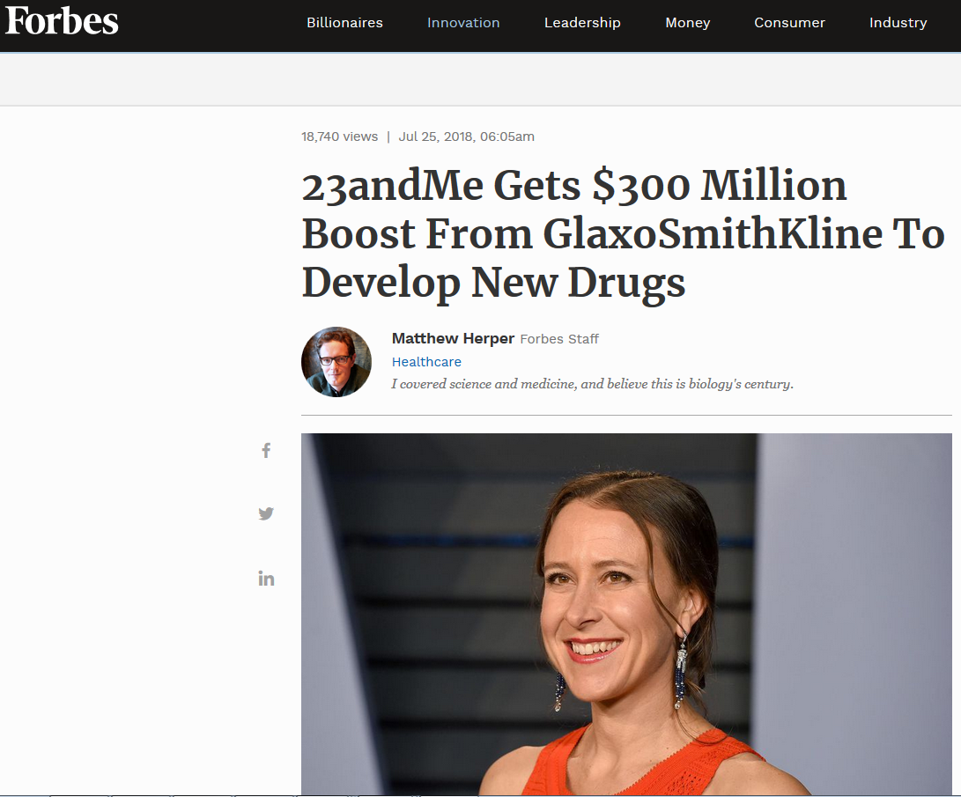
From: https://www.forbes.com/sites/matthewherper/2018/07/25/23andme-gets-300-million-boost-from-glaxo-to-develop-new-drugs/#494939bb3213
Notes:
GSK bought a $300K stake in 23andMe, using client’s DNA to develop new drugs
People paid for the service but will not be compensated for the use of their DNA; will have to pay for the drugs their genetic information is used to develop

Slide 12

From: https://arstechnica.com/tech-policy/2017/03/senate-votes-to-let-isps-sell-your-web-browsing-history-to-advertisers/

Slide 13
If I’m getting this thing for free, how is it funded?

Slide 14
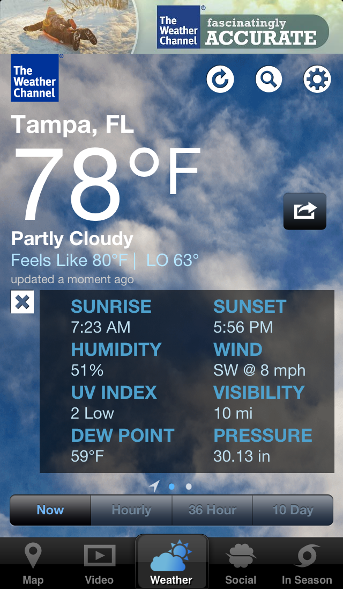

Slide 15
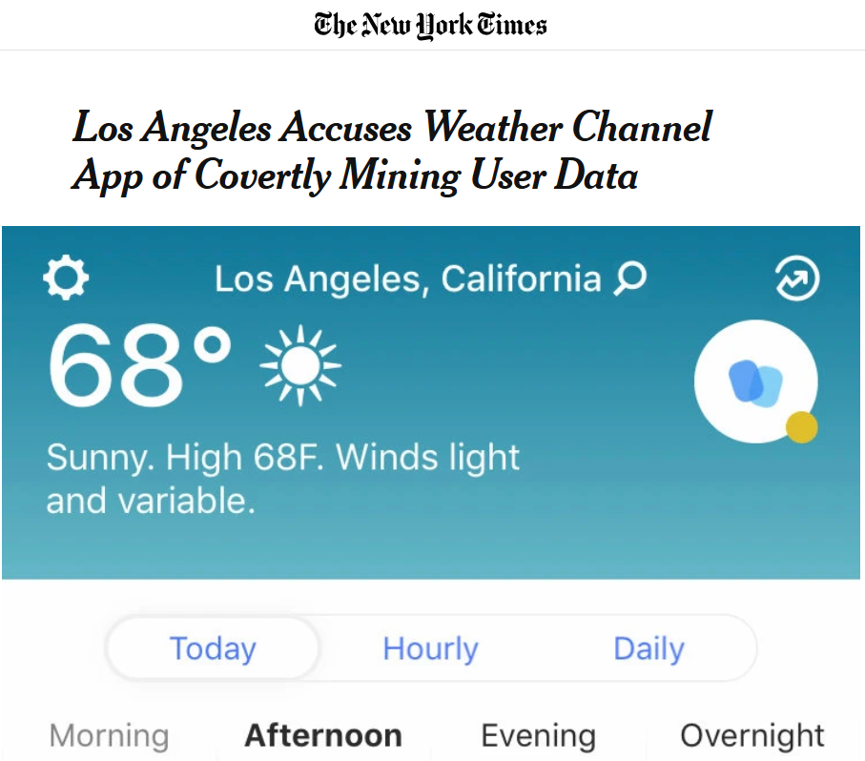
From: https://www.nytimes.com/2019/01/03/technology/weather-channel-app-lawsuit.html
Notes:
Unclear to users that when then clicked “OK” to share location data, that data was going to be sold to advertisers, stores, and investors
Location logs supposedly anonymized (i.e. not sold with user name), but include as many as 14K location data points per user per day

Slide 16
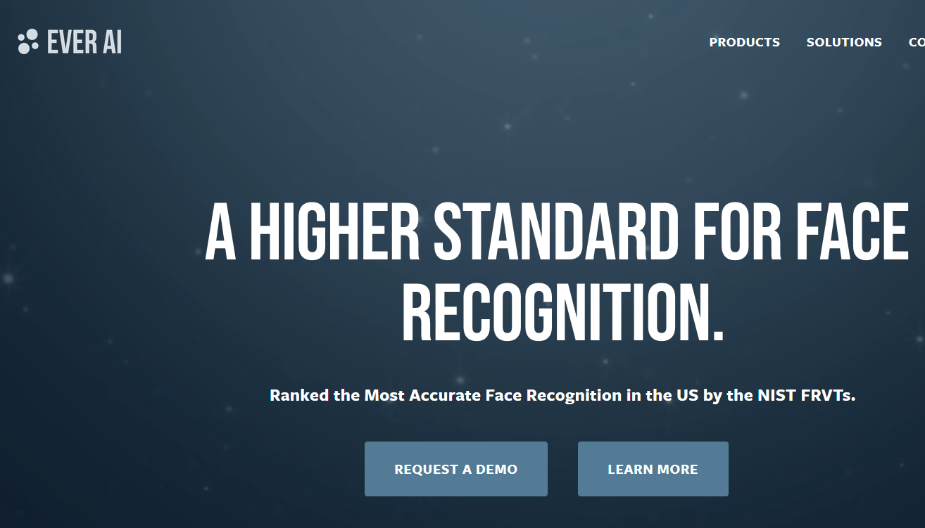
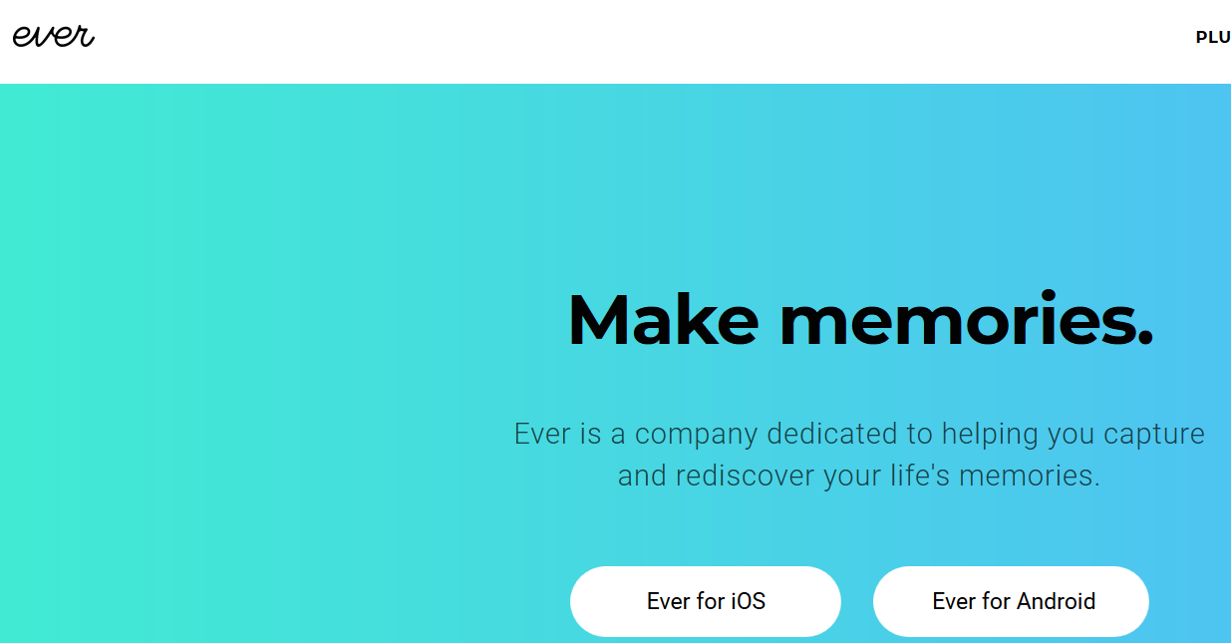
Notes:
https://www.everalbum.com/#main vs. https://ever.ai
Ever photo app, marketed to help people save space on phones by storing photos in cloud and making albums
Didn’t make clear to users that these data were being used to train facial recognition tech that was being marketed to law enforcement, military, etc.

Slide 17
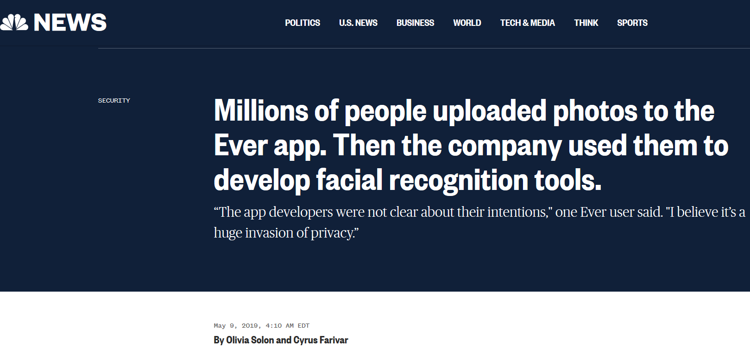
From: https://www.nbcnews.com/tech/security/millions-people-uploaded-photos-ever-app-then-company-used-them-n1003371

Slide 18
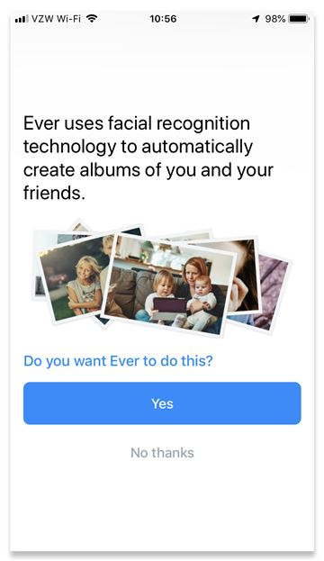
Notes:
New opt-in that was released after NBC broke story (screenshot from NBC article)

Slide 19
Does this technology or data collection disproportionately harm specific populations?

Slide 20
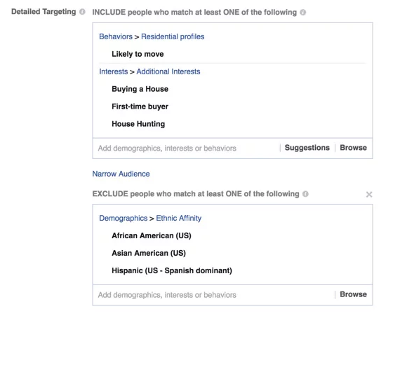
2016
From: https://www.propublica.org/article/facebook-lets-advertisers-exclude-users-by-race
Notes:
2016, ProPublica bought dozens of rental housing ads on Facebook, but asked that they not be shown to certain categories of users, such as African Americans, Asian Americans, Hispanics. Able to purchase the ads. In response, FB changed their system to require humans to review ads.

Slide 21
2017
From: https://www.propublica.org/article/facebook-advertising-discrimination-housing-race-sex-national-origin
Notes:
2017, ProPublica bought dozens of rental housing ads on Facebook, but asked that they not be shown to certain categories of users, such as African Americans, mothers of high school kids, people interested in wheelchair ramps, Jews, expats from Argentina and Spanish speakers. Approved by human reviewers within minutes.

Slide 22
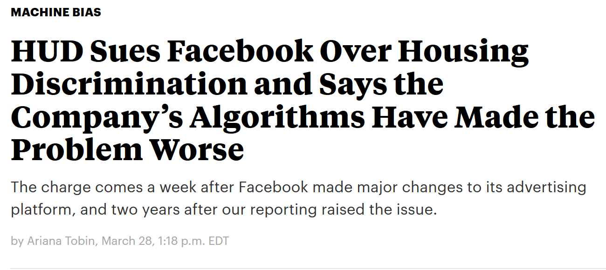
2019
From: https://www.propublica.org/article/hud-sues-facebook-housing-discrimination-advertising-algorithms
Notes:
2017, ProPublica bought dozens of rental housing ads on Facebook, but asked that they not be shown to certain categories of users, such as African Americans, mothers of high school kids, people interested in wheelchair ramps, Jews, expats from Argentina and Spanish speakers.

Slide 23
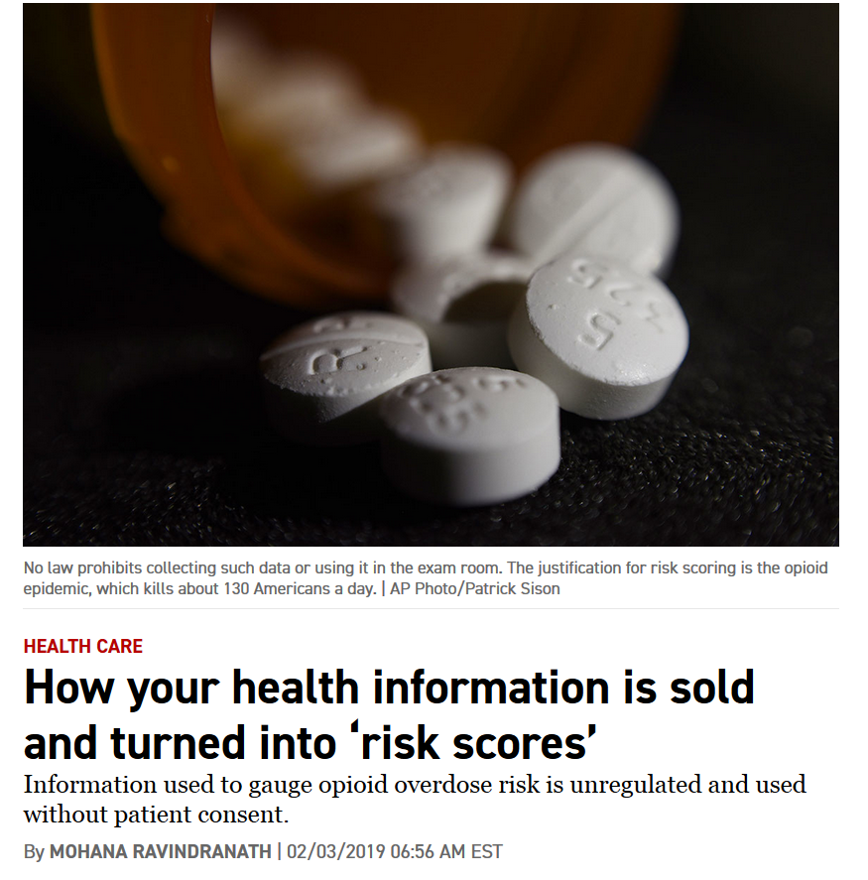
“While the data collection is aimed at helping doctors make more informed decisions on prescribing opioids, it could also lead to blacklisting of some patients and keep them from getting the drugs they need, according to patient advocates.”
“Over the past year, powerful companies such as LexisNexis have begun hoovering up the data from insurance claims, digital health records, housing records, and even information about a patient’s friends, family and roommates, without telling the patient they are accessing the information, and creating risk scores for health care providers and insurers. Health insurance giant Cigna and UnitedHealth's Optum are also using risk scores.”
From: https://www.politico.com/story/2019/02/03/health-risk-scores-opioid-abuse-1139978

Slide 24
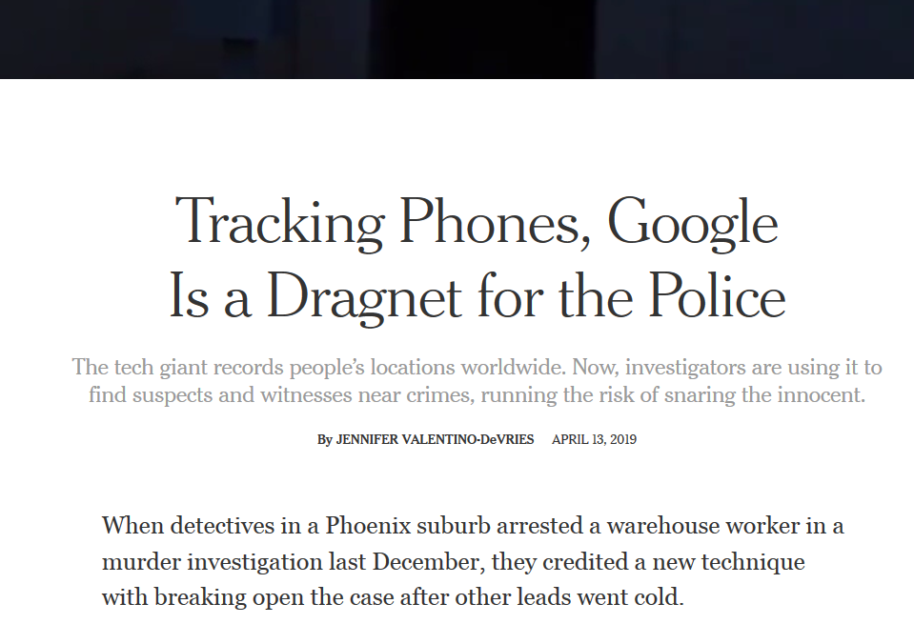
From: https://www.nytimes.com/interactive/2019/04/13/us/google-location-tracking-police.html

Slide 25
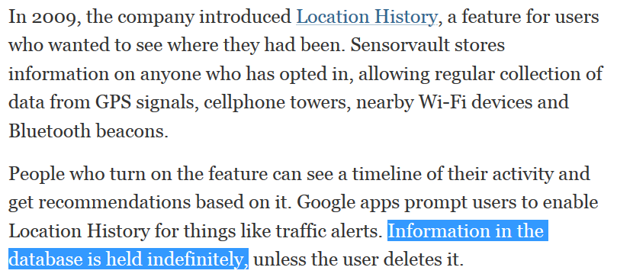
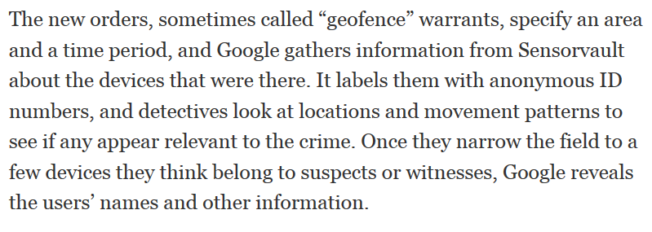
Notes:
So what? Well, when police get it wrong, it has real-life consequences
Article talks about a man, Jorge Molina, who was arrested based on this cell data for a murder it later turned out he didn’t commit. “Mr. Litwak said his investigation found that Mr. Molina had sometimes signed in to other people’s phones to check his Google account. That could lead someone to appear in two places at once, though it was not clear whether that happened in this case.” His friend had texts and Uber receipts showing Molina was with him when the crime occurred. Police arrested Molina at his job and he spent a week in jail. He was fired from his job because of the arrest and his car was impounded (his mother’s boyfriend, who was later arrested for the crime, apparently used Molina’s car to commit the murder)

Slide 26
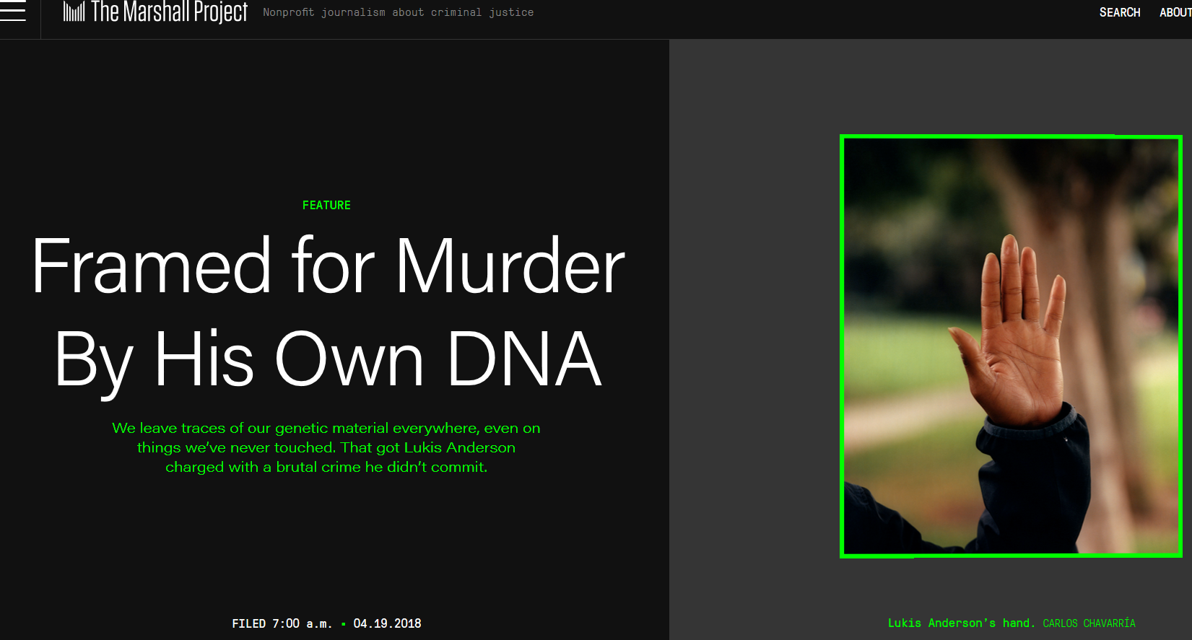
From: https://www.themarshallproject.org/2018/04/19/framed-for-murder-by-his-own-dna
Notes:
Lukis Anderson was charged with murder for a brutal home invasion and murder, even though he was in the hospital at the time of the crime
His DNA was found on the victim’s fingernails; turned out that it was transferred by a paramedic who had taken Anderson to the hospital and later reported to the scene of the murder
Anderson spent nearly 6 months in jail, and was facing a murder charge that could have carried the death penalty

Slide 27
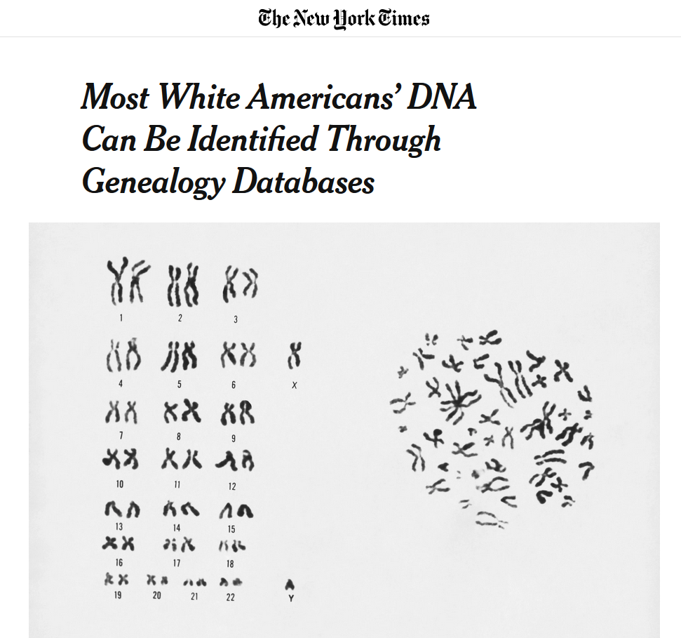
From: https://www.nytimes.com/2018/10/11/science/science-genetic-genealogy-study.html?rref=collection%2Fsectioncollection%2Fhealth&action=click&contentCollection=health&region=stream&module=stream_unit&version=latest&contentPlacement=31&pgtype=sectionfr
Notes:
Approximately 60% as of October 2018
Estimated to go up to 90% within 2-3 years
2008 Genetic Information Nondiscrimination Act prevents employers from discriminating based on DNA info about a person, but it’s going to get a whole lot easier

Slide 28
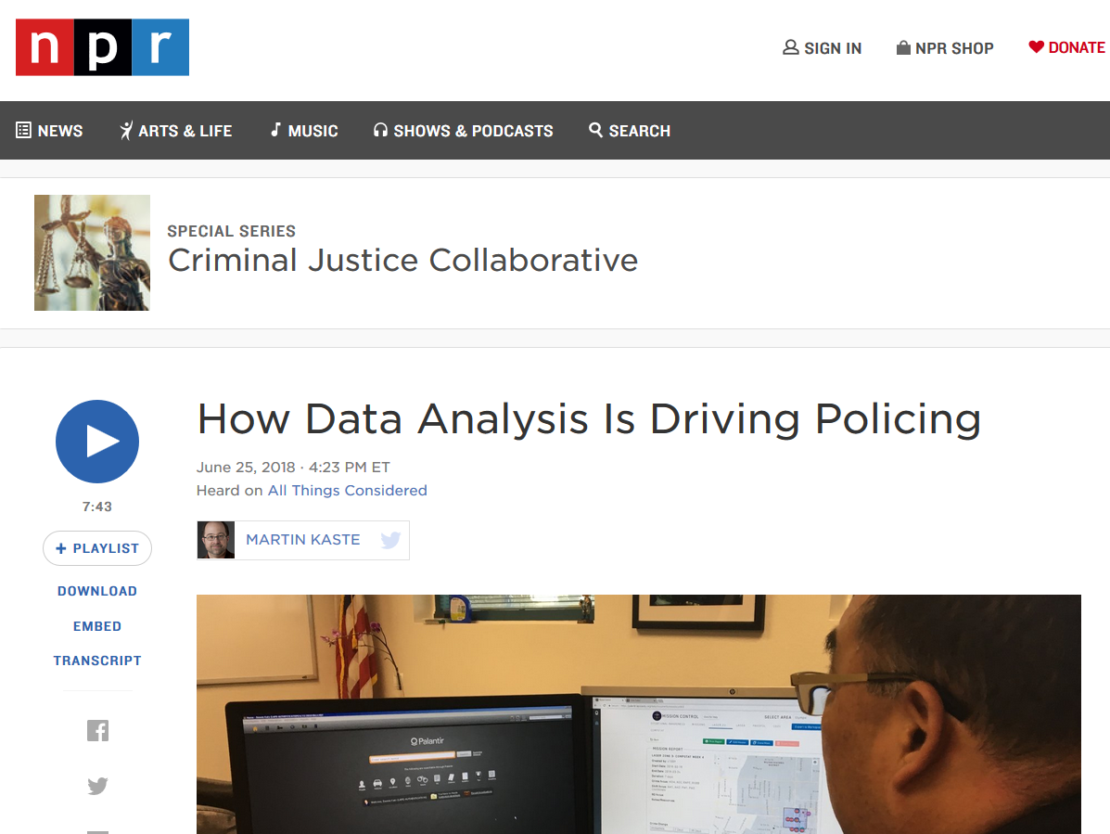
AI replicates the biases of underlying data
From: https://www.npr.org/2018/06/25/622715984/how-data-analysis-is-driving-policing
Notes:
“LAPD has been expanding "Operation LASER," which uses near-real-time crime data to adjust police patrols on a daily or even hourly basis. “
The "Chronic Offenders Bulletin" may be the most controversial element of LAPD's new data analytics strategy. It's a list of the people in a certain neighborhood who police think are most likely to commit crimes. Chronic offender status is based on a point score, which is calculated on the basis of his previous interactions with the justice system, or membership in a gang. The LAPD's new data search tools make calculating that score much simpler.”
“the chronic offender formula is partly based on how often you have contacts with the police — "field interviews," she says. And those contacts are simply more likely in a place that already has more police patrols.
"The bias is still very much inherent in the data that is being used, and the same communities are being impacted," she says.”

Slide 29

From: https://www.amazon.jobs/en/jobs/836421/managing-editor-news

Slide 30
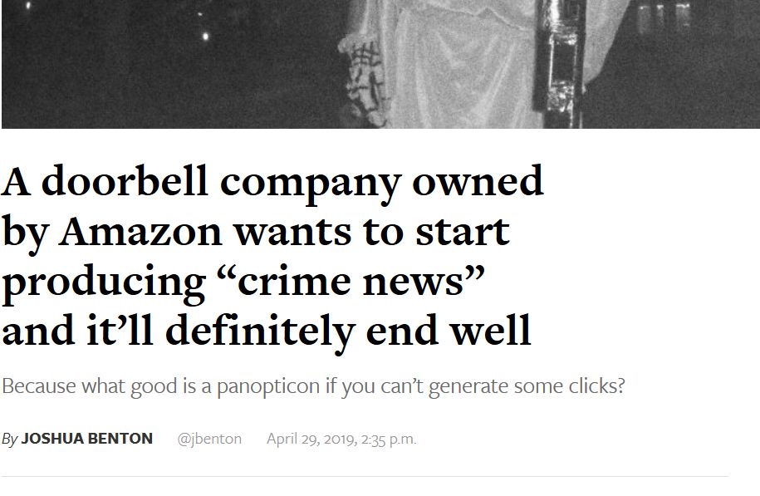

From: https://www.niemanlab.org/2019/04/a-doorbell-company-owned-by-amazon-wants-to-start-producing-crime-news-and-itll-definitely-end-well/

Slide 31
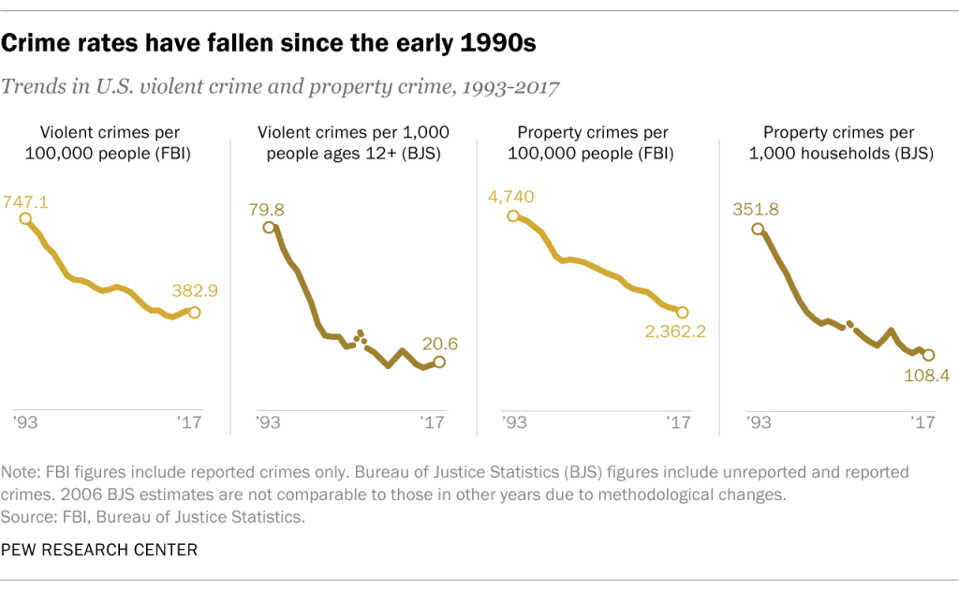
How do you scare people into buying your product?
From: https://www.pewresearch.org/fact-tank/2019/01/03/5-facts-about-crime-in-the-u-s/

